Slide 1
Custom Expressions

Slide 2
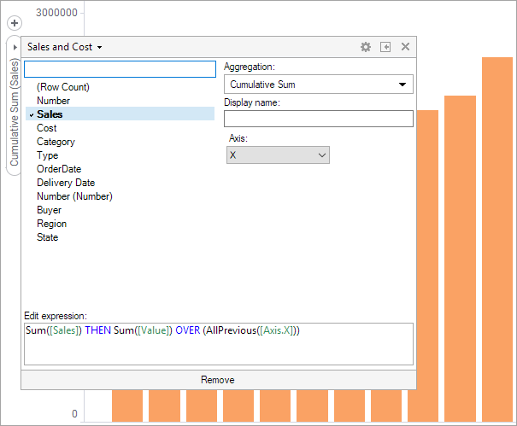
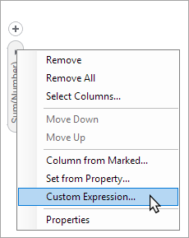
Introduction

Slide 3
Custom Expressions Overview
Markers are, quite simply, a representation of how you have divided your data into different slices. A marker can represent everything from all rows in your data to a single row, depending on how you have set up your visualization.
Setting up a visualization is basically deciding how the data is to be divided and how the data is to be aggregated over the slices. For example, if the aggregation method is Sum(), the total value of all sales for each product and year are summed up in one marker.

Slide 4
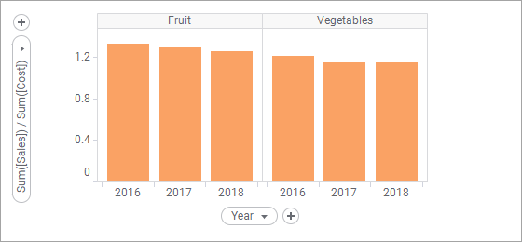
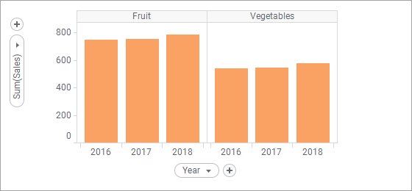
Basic Custom Expressions

Slide 5
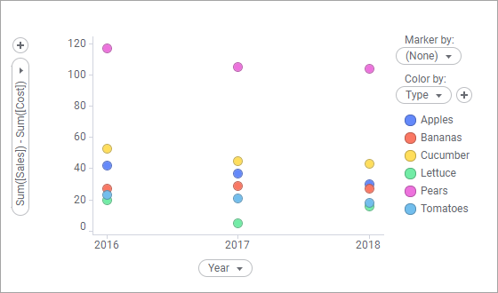
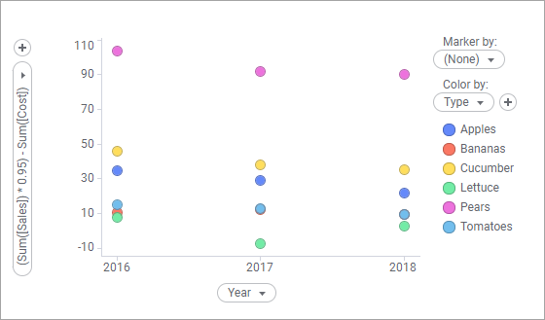
Basic Custom Expressions

Slide 6
Aggregations in Custom Expressions
Region Product Sales
EAST Phone 42
EAST Phone 118
EAST Chair 190
WEST Desk 19
WEST Chair 20
CENTRAL Phone 18
CENTRAL Desk 17
CENTRAL Desk 12
CENTRAL Desk 13
CENTRAL Chair 20

Slide 7
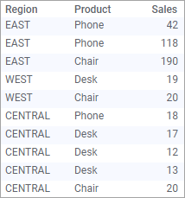
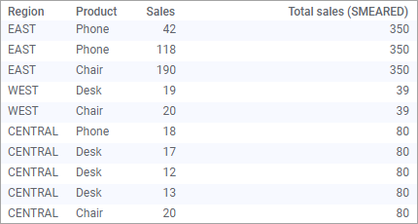
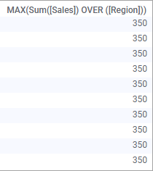

Example – Max Total Sales per Region
As calculated column: Max(Sum([Sales]) OVER ([Region]))
Totals
Extend
Project

Slide 8
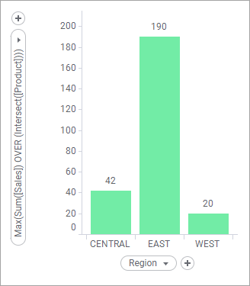
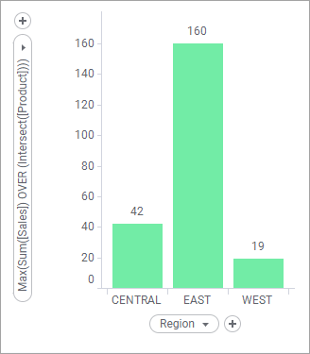
Example – Best selling product per region
When used in visualizations, nested aggregations can take filtering into account. Examples below are with and without “Chair”.

Slide 9
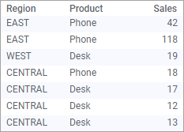
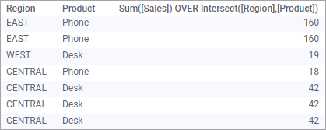

Aggregation in Custom Expressions
Filtering
Pairwise
Project

